Slide 1

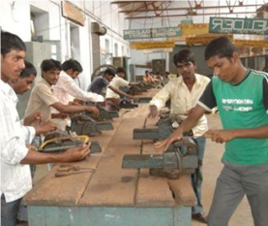

Skills for Rural Youth: Issues and Challenges
Prof MP Poonia
Director, NITTTR (India)
National Institute of Technical Teachers Training and Research
Sector-26, Chandigarh (India)

Slide 2
PROGRAMMES &
ACTIVITIES (NITTTR)
Education & Training
Curriculum Development
Instructional Material Development
Research & Development
Extension & Consultancy

Slide 3

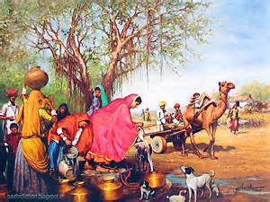
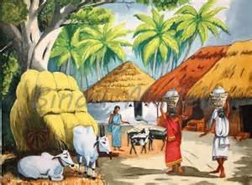
Global Context (contd.)
Out of 7.0 billion population of the world, around 3.3 billion stays in villages.

Slide 4


Global Context
World is home to about three million villages, of which 92 per cent are in the developing world.

Slide 5
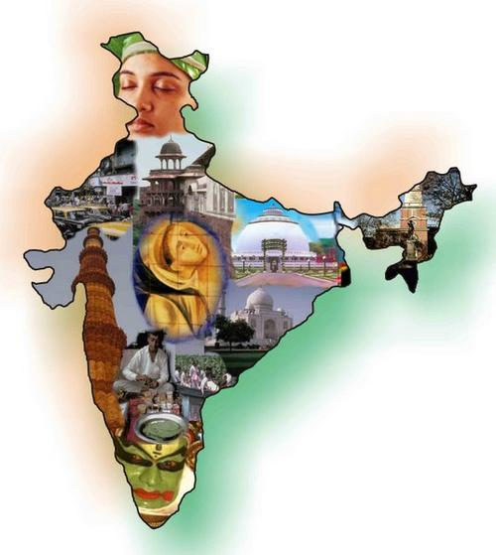
Indian Context

Slide 6
Indian Context (contd.)
Largest Democracy in the World , 1.2 billion
population.
“Youngest nation” in the world with 54% population
under the age of 25 years.
Total Workforce of 459 million.
India has 3rd largest education system globally.
Spends at 3.7% of GDP.
Global Skilled Manpower Shortage of 56.5 m by 2020
while India to have Surplus of 47 m.
Economic Growth @9%.

Slide 7
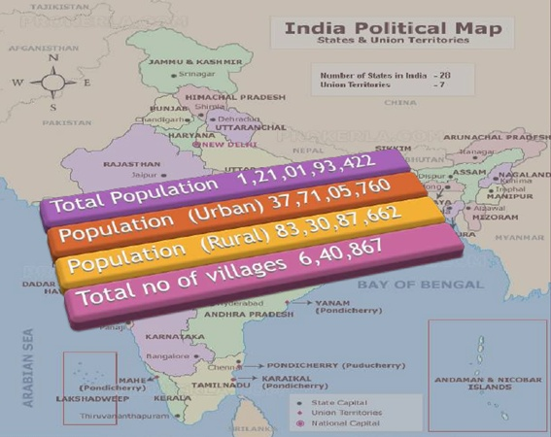

Slide 8

Gross Enrollment Ratio
The government has begun efforts to enhance Gross Enrolment Ratio (GER) in higher education to
30 % by 2020 from
the current level
of around 19 %.

Slide 9
Education & Employment Status in Indian Context
1,50,000 are going abroad for higher education
Govt. Job: 1%
Pvt Job (organized) 2%
Unorganized 97%
41 million– registered in the employment exchange
290 million unregistered or unemployed
Only 2% skilled population out of 97%
Notes:
As a result of these gaps what is the present status of education?
Though India says 61% literacy, It is who signs and cannot read and write. 35% of Indians are having primary education.
9

Slide 10

Indian Workforce (contd.)
It is necessary to increase access of marginalized communities to skill development opportunities & improve their employability.
An estimated 50–70 million jobs will be created in India over the next five years and about 75%–90% of these additional employment avenues will require some vocational training

Slide 11


Slide 12
Challenges For India
Vocational Skills in India Compares Unfavorably to other countries.
India Receives only 8% formal Vocational Training which is very less.
%

Slide 14
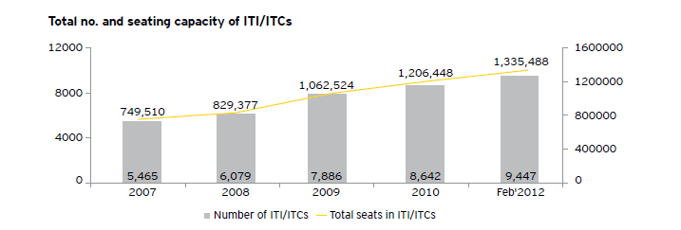

Slide 15


Slide 16
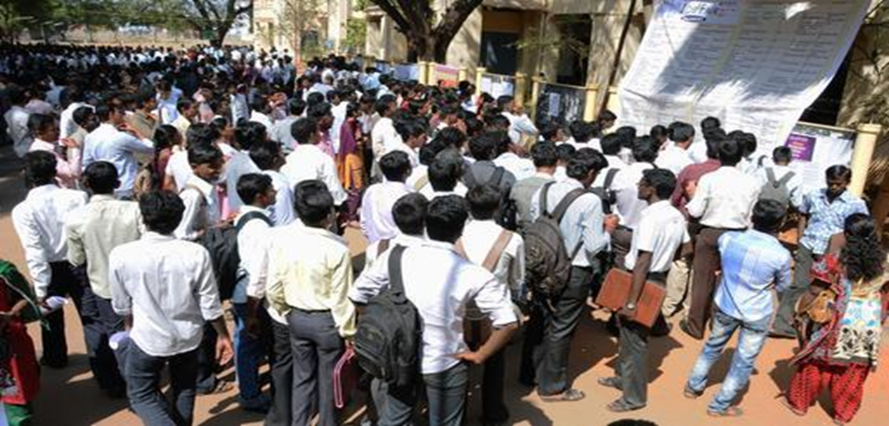
Indian Workforce
India has one of the highest numbers of youth entering the workforce every year.
However very few among them have formal training, some receive on-job training while almost 90% are unskilled

Slide 17
What Shall Be Done?

Slide 18
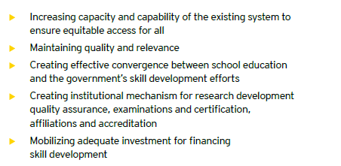

Slide 19


Slide 20
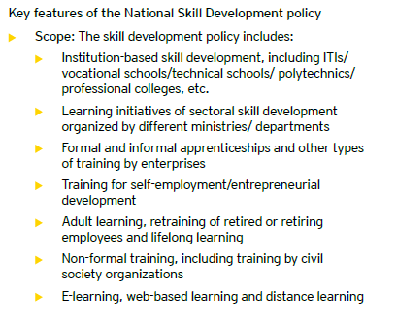

Slide 21
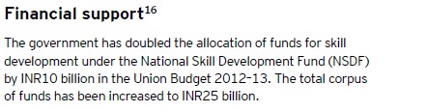

Slide 22
Knowledge centre
Unique ID of Trainee
Data Collection
Evaluation & Analysis
Reporting
Ignition
&
Training
Ethics & Values
Different Levels of Skills Develop-ment
Village Employ-ment
Training of Rural Youth will
Transform
India
Notes:
22
Every student who ever undergoes Lead India Training will be given an ID thru which we will norture Values in Phase II and develop Skills in IIIrd Phase and help them till they become employed or sets business.

Slide 23
Technical and Vocational Education System in India
Central Government
Prime Minister’s National Council on Skill Development
Vision
Massive ambition manifesting in creation of 500 million skilled people by 2022;
High inclusivity;
Dynamic and self-healing adjustment process; and,
Focus on outcomes, consumer choice and competition.

Slide 24
Skill Pyramid (Total 500 Million)
Highly
Skilled
College Educated
Vocationally Skilled
Minimally Educated/
Requiring Modular Skills
Level 4 : 5%
Level 3 : 20%
Level 2 : 25%
Level 1 : 50%

Slide 25
High Growth Rate Sectors
Automobile
Tourism, hospitality and travel
ITES-BPO
Transportation/ logistics/ warehousing and packaging
Retail
Real estate
Media, entertainment, broadcasting, content creation, animation
Healthcare
Banking/ insurance and finance
Education/ skill development
Un- organised sector
Electronics hardware
Textiles and garments
Leather and leather goods
Pharmaceuticals
Gems & jewellery
Building and construction
Food processing
Handlooms & handicrafts
Building hardware and home furnishings
IT or software

Slide 26
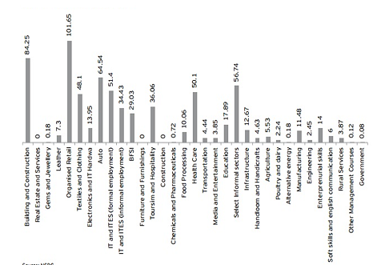
Sector Wise Skilling Target

Slide 28

Key Policies & Initiatives
  National Policy on Skill Development
  Skill Development Initiative Scheme
  Craftsmen Training Scheme
  NVQF
  NVEQF

Slide 29
Technical and Vocational Education System in India
Central Government
National Skills Development Corporation (NSDC)
Objective
To contribute significantly (30%) to the overall target of skilling 500 million people in India by 2022, mainly by fostering private sector initiatives in skill development programmes and providing funding.

Slide 30
National Skills Development
Corporation (NSDC)
It funds private sector skills training providers to setup centers in various high labor demand sectors.
The training centers of investee companies envisaged is 14000 and the average number of students per center per year is approximately 4153

Slide 31

Industry Associations
CII
ASSOCHAM
FICCI

Slide 32
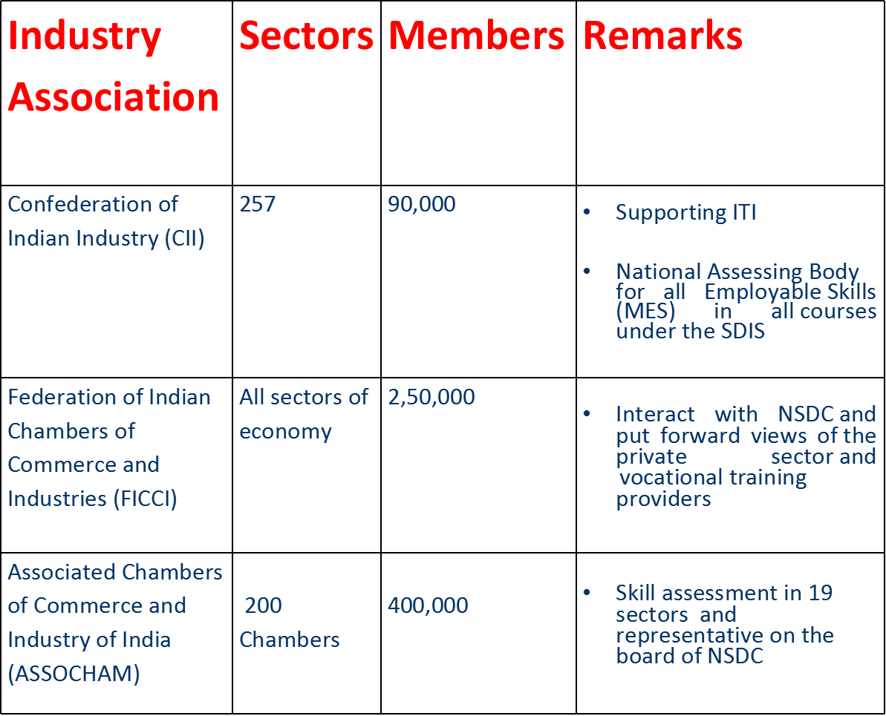
Industry Associations (contd.)

Slide 33
Technical and Vocational Education System in India
Ministry of Human Resource Development
Department of School Education and Literacy (for TVET programmes in senior secondary schools)
Department of Higher Education (for Technical Education)

Slide 34


International Bodies
ILO
World Bank
European Union

Slide 35
International Labor Organization
Supporting the technical processes of the
National Policy on Skills Development
(NPSD)
Implementation of SDIS in selected clusters
Relevant studies, for evaluation of ITIs and
Methodology for identification of skills needs
Implementation of pilot programs in selected
areas
Source: ILO, Synovate Interviews & Analysis
*

Slide 36

European Union
The EU is supporting the SDIS by providing a
grant of 6.5 million Euros (INR 417.5 million)
The purpose of the EU support is to increase the
capacity of DGE&T, NCVT and NSDC to
implement the NPSD agenda
Results expected are:
  Progress in the development of NVQF
  Development of LMIS and analysis practices
*

Slide 37
World Bank
World Bank has provided 70% of the total cost of INR 15.81 billion for the Vocational Training
The Project Aims To:
    Upgrade 400 ITIs as Centers of Excellence
    Train the instructors
    Support studies set up NVQF
    Provide incentive funds to states for good
    Performance in project implementation
*

Slide 38

Public Private Partnership/
Private Sector Initiatives
India Skills India Can
Centum Learning IL&FS

Slide 39


Private Players’ Initiatives
Educomp is a globally diversified and largest education company in India
It has joint venture with Pearsons Education to form India Can to provide vocational training
Bharti is one of the largest business groups in the telecom and retail in India
It has established
Centum Learning to
provide learning and
skill- building solutions

Slide 40


Private Players’ Initiatives (contd.)
Manipal Education is the largest education services providers in India
It has entered into a joint venture with City & Guilds UK to form IndiaSkills that provides industry-relevant skills
ILFS is one of India's
leading infrastructure
development companies
It has established a
business unit called the
Cluster Development
Initiative to impart skills
training

Slide 41

Challenges (Contd.)
Relevance:
Low industry interface
Systemic Gaps:
Labor Market Information System
Sector Skill Councils
NVQF
Re-engineering of NCVT as National Vocational qualification and accreditation authority.

Slide 42

Challenges (Contd.)
Socio-Cultural and Socio-Economic Diversity:
Diverse socio-cultural and socio-economic background, becomes hindrance in offering a standardized programme
Need for Convergence for Skill Development:
Strategies and approaches to skill development are different

Slide 43

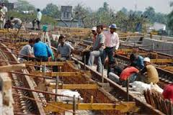
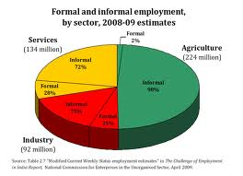
Challenges (Contd.)
The Gigantic Task
500 million persons in a variety of skills by the year 2022
Involvement of Multiple Agencies/ Departments/ Ministries:
There are 17 ministries/departments of Govt of India

Slide 44

Challenges (Contd.)
Standardization of Curriculum and Instructional Resources:
A massive effort is required in evolving curriculum and designing instructional resources.
Inadequate Infrastructure:
Hardware, building, space ,power supply lacking in rural areas.

Slide 45

Challenges (Contd.)
Shortage of Competent Trainers:
Almost for all skill courses there is a serious shortage of competent trainers.
Involvement and Commitment of Private Sector:
All students may not get opportunities for acquiring hands on skills.

Slide 46

Challenges (Contd.)
Equivalence of Skill Qualifications:
Skill qualifications offered , many a times, are not equated with skill qualifications available abroad.
Social Acceptability of Skill Courses:
Social stigma becomes a de motivating factor for youth.

Slide 47

Challenges (Contd.)
Mindset of Present Generation:
Mindset of present generation is in favor of undergoing training pertaining to white collar jobs
Delay in Evolving Sector Skill Councils and National Occupational Standards
Evolving up to date curriculum can’t be met in absence of National Occupational Standards.

Slide 48

Challenges (Contd.)
Design of Curriculum by Experts from Formal Sector:
It would made curriculum more relevant if the informal sector is involved in curriculum design.
Absence of Manpower Forecasting:
There is no authentic manpower forecasting mechanism in place in India.

Slide 49

Challenges (Contd.)
Bringing skill development within the domain of universities:
The universities should become a significant partners in implementation of Skill Development Mission of the Govt of India.

Slide 50

Conclusions
In a nutshell, the building blocks of any skills strategy must be solid foundation skills.
Stronger links between the worlds of education and work.
Good-quality education in childhood.
Good information on changes in demand for skills.

Slide 51

Conclusions (contd.)
Training Systems shall be Responsive to Structural Changes in Economy and Society;
Recognition of Skills and Competencies
To Ensure Equity
Accreditation, Assessment, Certification
Mobilising Adequate Funds for Training

Slide 52


Thanks

